Slide 1
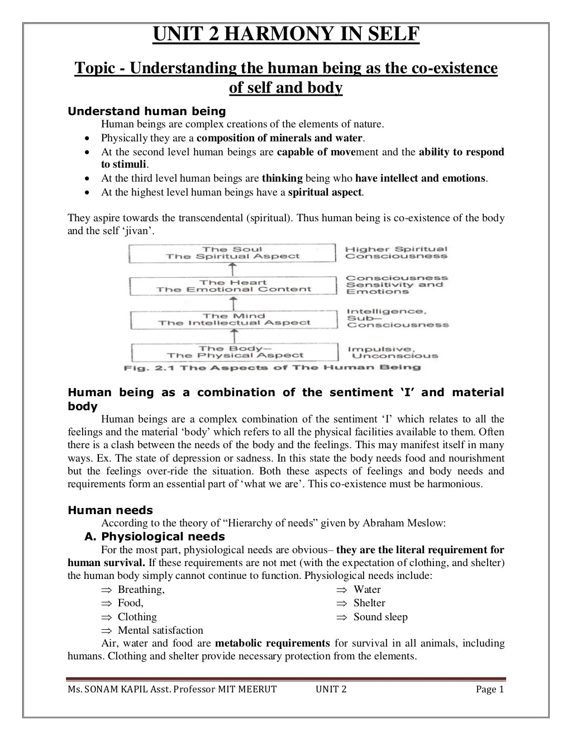

Slide 3
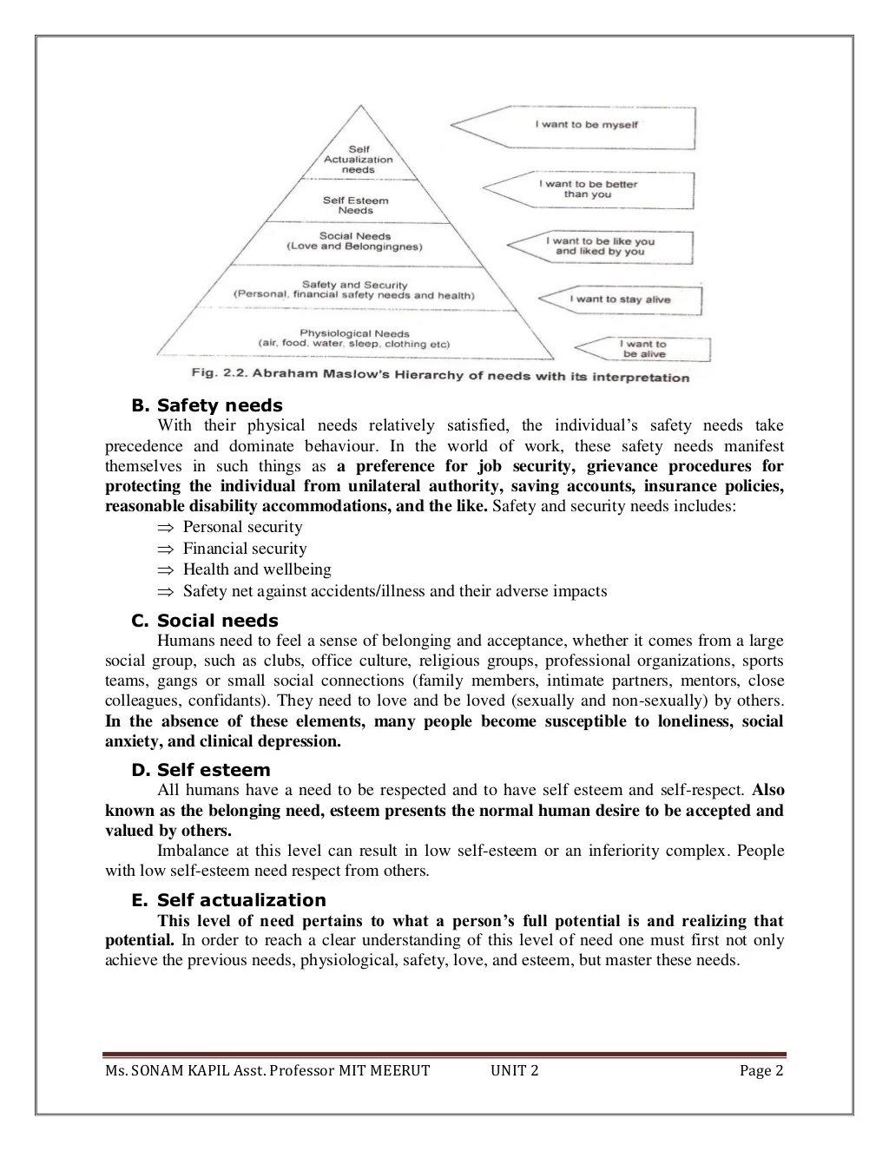

Slide 6
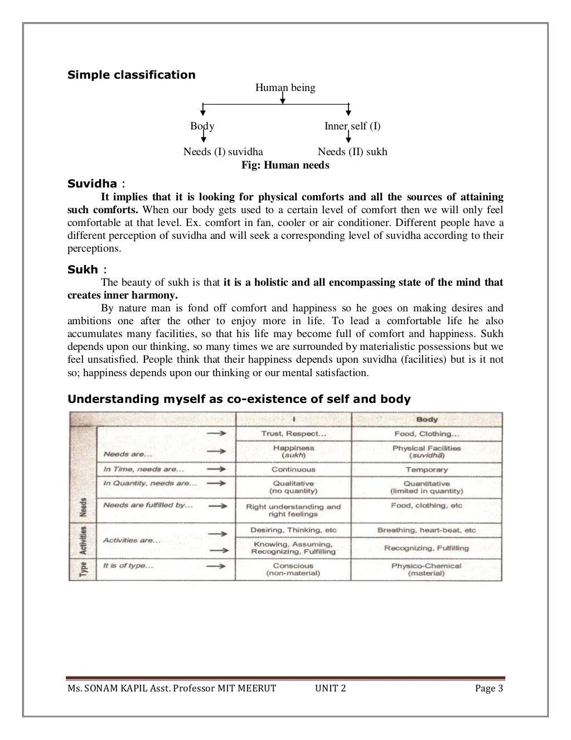

Slide 9
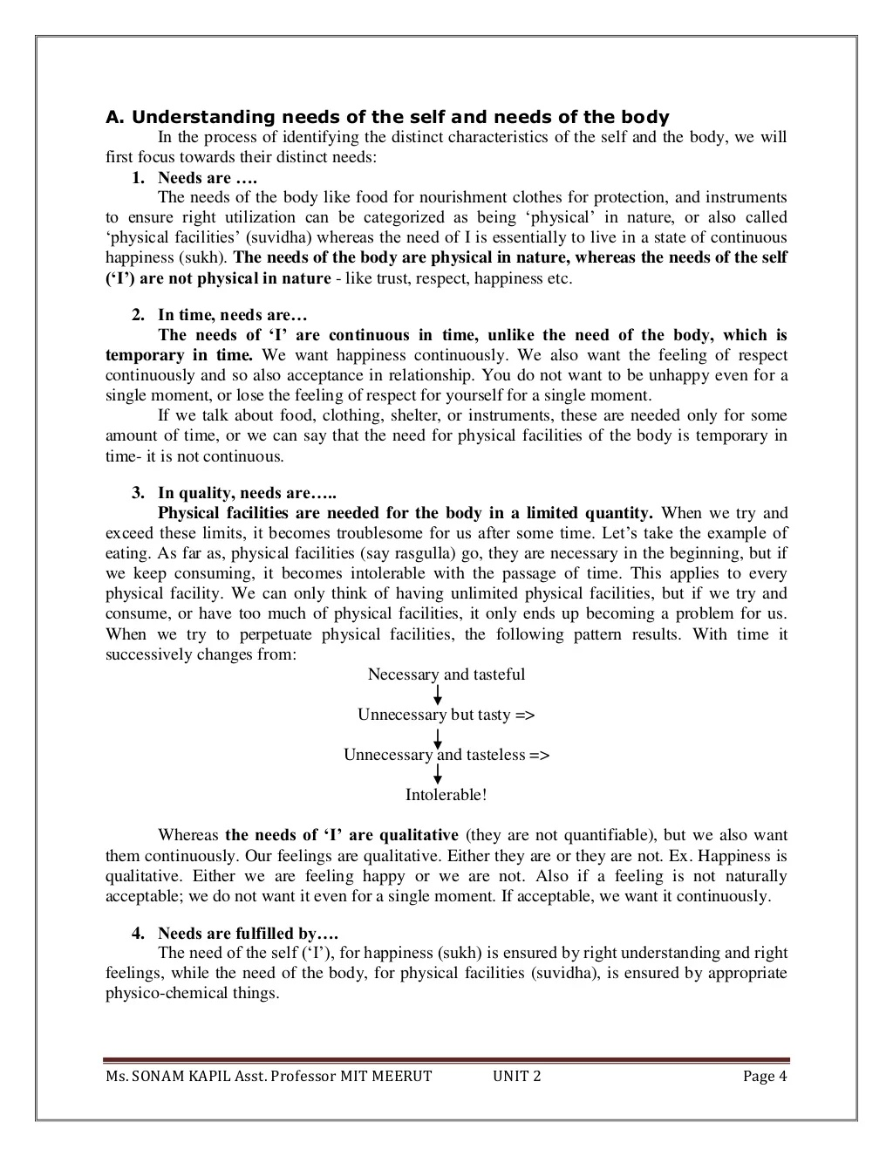

Slide 11
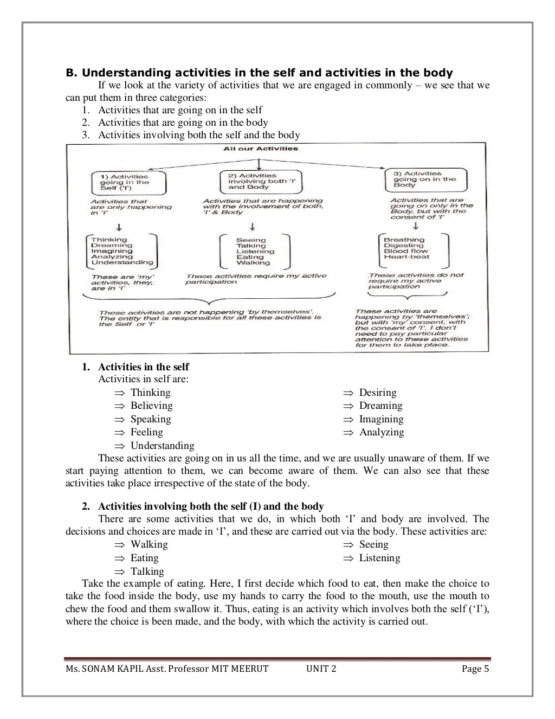

Slide 13
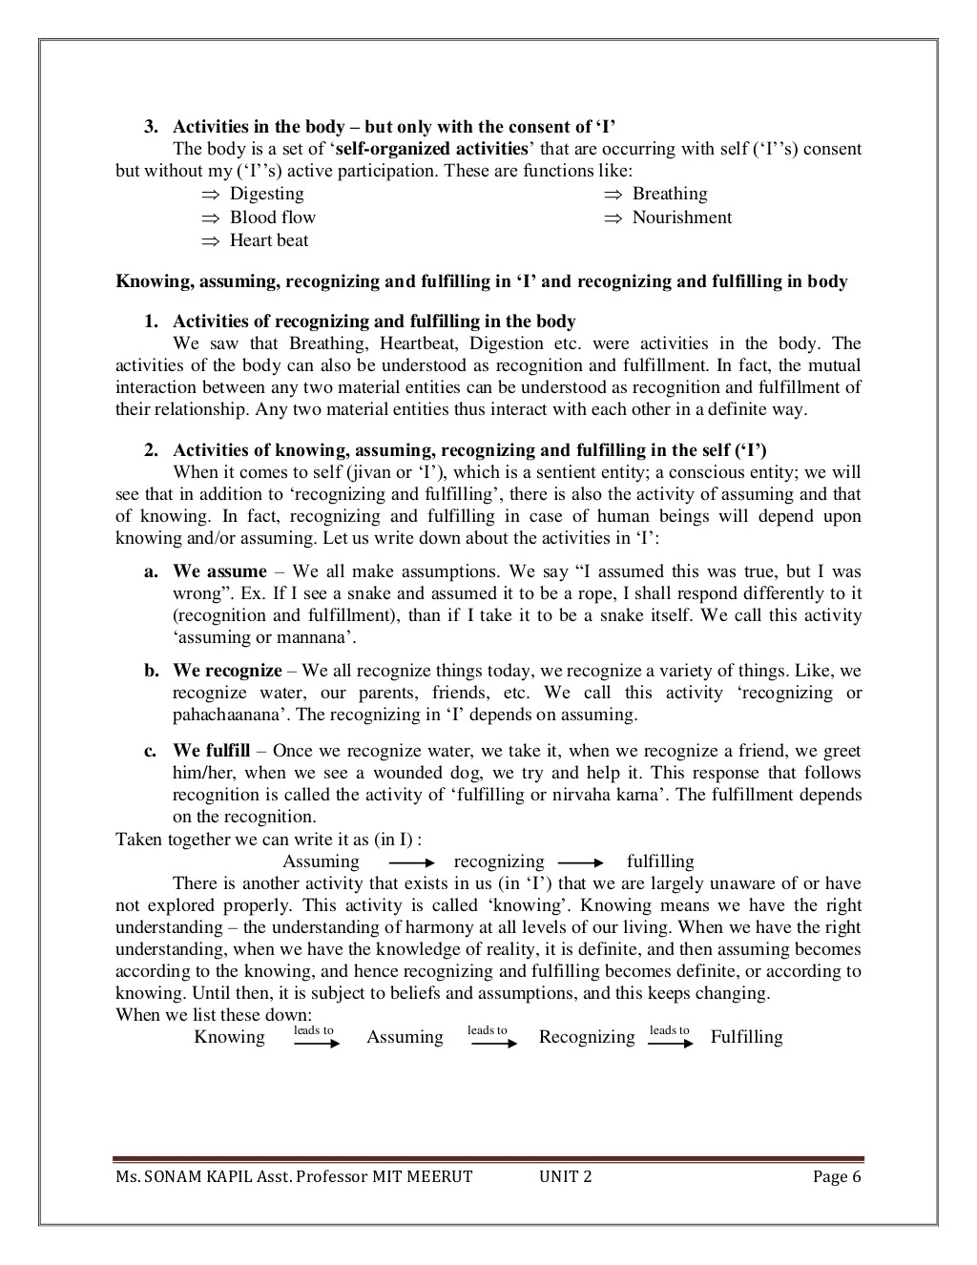

Slide 17
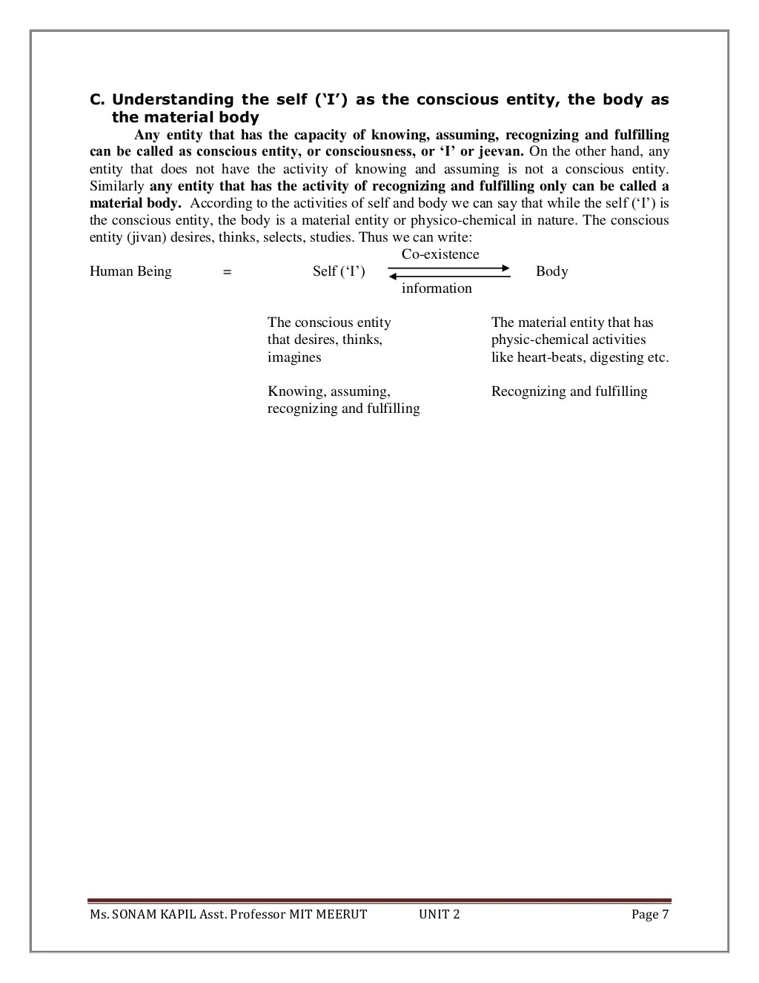

Slide 18
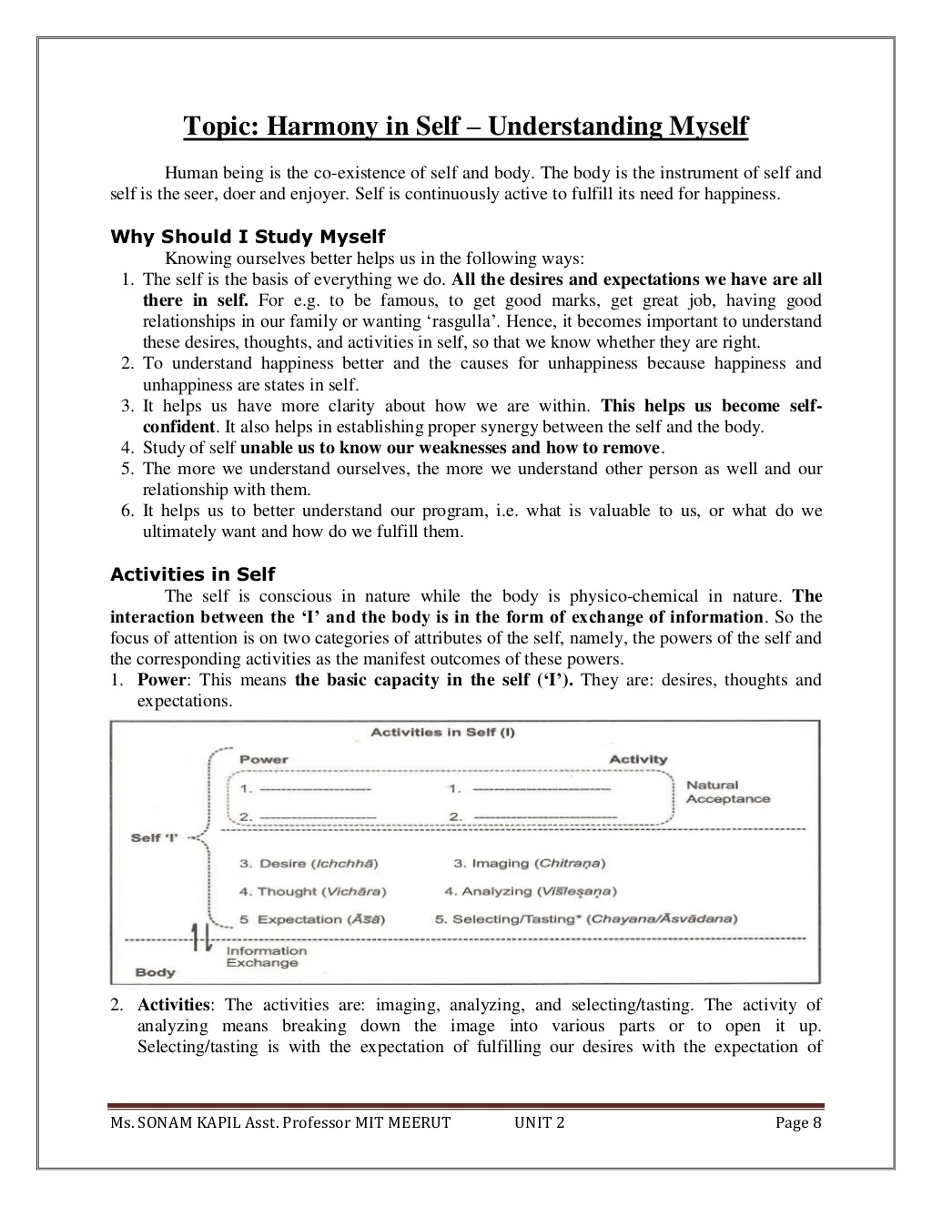

Slide 36
Right utilization of the body?
Normally we tend to believe that the body is an instrument for sensory enjoyment, which is not correct. It also happen to our body to exploit other human beings or rest of the nature, which is also not right utilization.
Body is the instrument of the self and the body needs to be given nutrition, protection and utilized to work as an efficient and effective tool for the right purpose. This utilization is termed as right utilization.
In other words, employing our body as an instrument for sensory enjoyment, and to exploit other human beings or rest of the nature is not the right utilization. On the contrary utilizing our body for right behaviour and work is actually the right utilization of the body.

Slide 53
“I am the seer, doer and enjoyer. The body is my instrument”
There is a relation between the self and body that body act as an instrument of self. Whatever self thinks body performs it physically. Body does not decide itself. We can verify this by the following discussion.
I am the seer: When we are reading a book or listening, when someone is explaining something to us, when we are watching a scenery or when we are thinking – we are engaged in the activities of ‘seeing’ or understanding. Now when we see some nice scenery we say ‘I am seeing’ that means our self ‘I’ see via the eyes, the eyes don’t see, they are just instruments, that

Slide 54
unable me to see something outside. Different images are formed in the eyes every time, but it is I who is able to relate it to the meaning of that image every time. Similarly, I can see inside ‘in me’ also – without the eyes. For example I can see that I am getting angry. In this case I understand or know or am aware that I am getting angry. When I see outside the body works as an instrument.
I am the doer: once I have seen/ understood something, I am the one who decides what to do or not to do. I am the doer. For example, when I see the scenery I am the one who decide to take a picture of the scenery. I use my hands to pick camera and click a picture. The hands in the body are thus used as an instrument. In this way I work with my hands and legs.

Slide 55
I am the enjoyer: I saw the scenery and I took the picture. I am the seer and doer so far. When Isee the picture I like it. I am the one that enjoys it. Thus there is a continuity of being the seer,doer and enjoyer. Similarly when I eat, I am the one that gets the taste – from the tongue.

